Slide 1

Author: Felix Weigl
V2 – Jan 2026
OpenTofu Training

Slide 2


Agenda
OpenTofu Overview
Tofu Basics
Variablen und Schleifen
Tofu Advanced

Slide 3
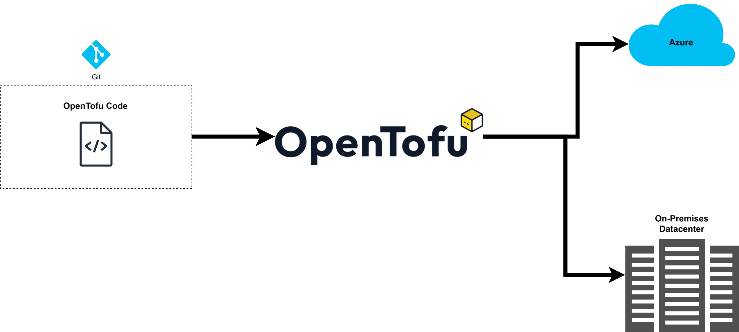
Tofu Overview
IaC
Infrastructure as Code
Notes:
Avoid manual configuration to enforce consistency.
Mail server example.
Scalable.
Versioning.
Code becomes valuable and worth protecting.
Error prevention: Avoid manually configuring five servers.
Flexible.
Lintable (manual configuration not possible).
Reusable! Set it up once, then simply configure it as needed.
Terraform handles the work for us and evaluates the code.

Slide 4


Tofu Overview
Provisioning
Configuration
Notes:
In a home lab, you should clearly separate: Ansible for configuration and Terraform for infrastructure setup.
Stateful
Terraform builds infrastructure.
It also handles the teardown of VMs, etc.
Files are dynamic when users make changes.
API CALLS!!! Terraform handles API calls, while Ansible uses SSH. Both have a low footprint.

Slide 5
Tofu Basics
Provider
"Plugins" or "Providers" of various Resources and Data Sources
HCL
Hashicorp Configuration Language
Resource
Infrastructure/Resource to be created.
Data Source
Data to be retrieved/read from an infrastructure.
Outputs
Any return values to be processed or output in the Terraform code.

Slide 6
Tofu Basics
Input Variables
Variables to populate parameterized code.
Locals
On-the-fly "variables" (modifying existing vars/returns).

Slide 7
Tofu Basics
Hands On
Notes:
01-basic
02-vars

Slide 8
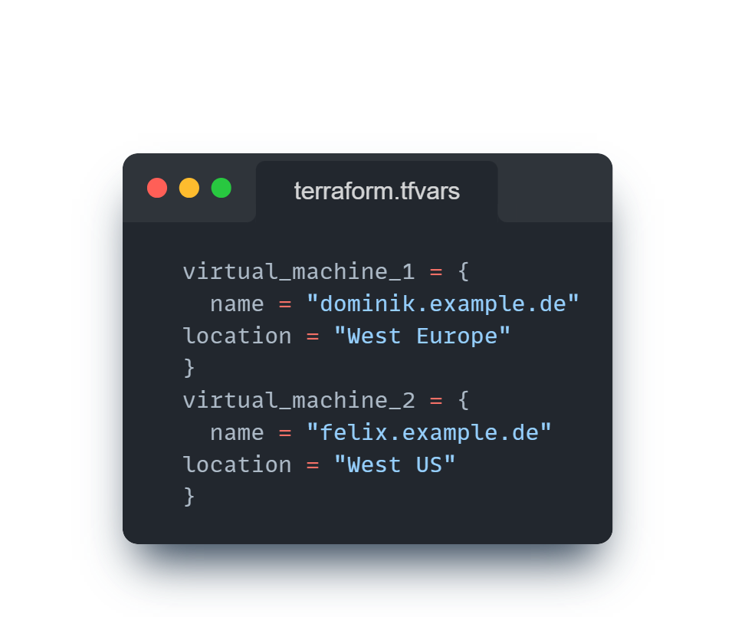
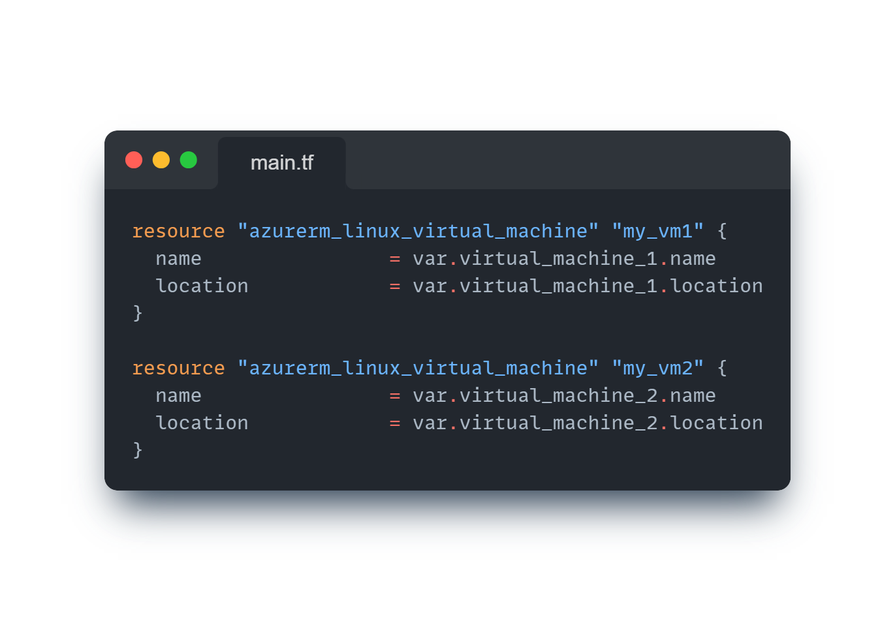
Tofu Advanced

Slide 9
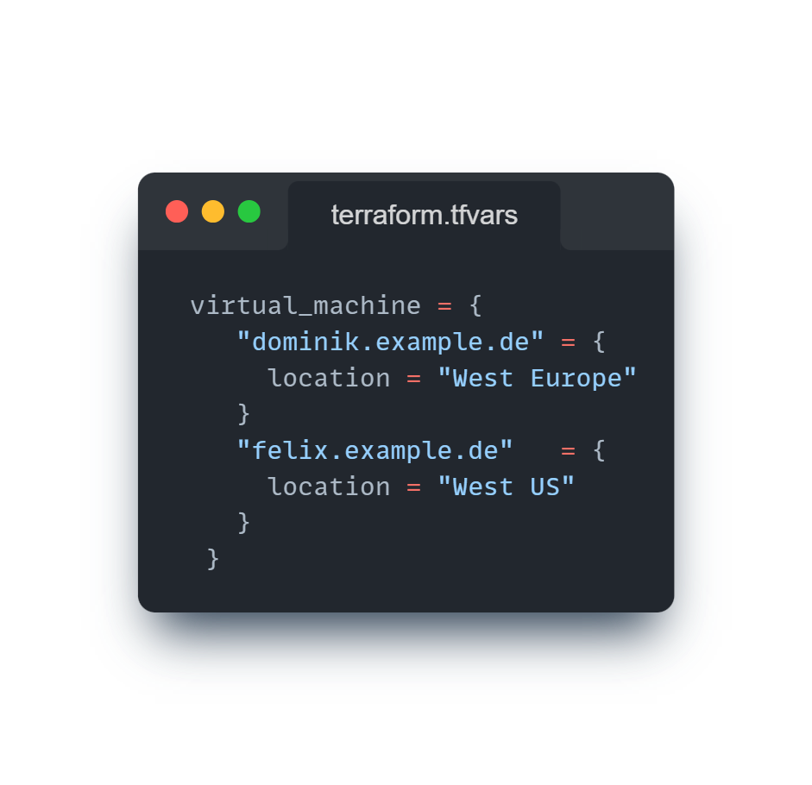
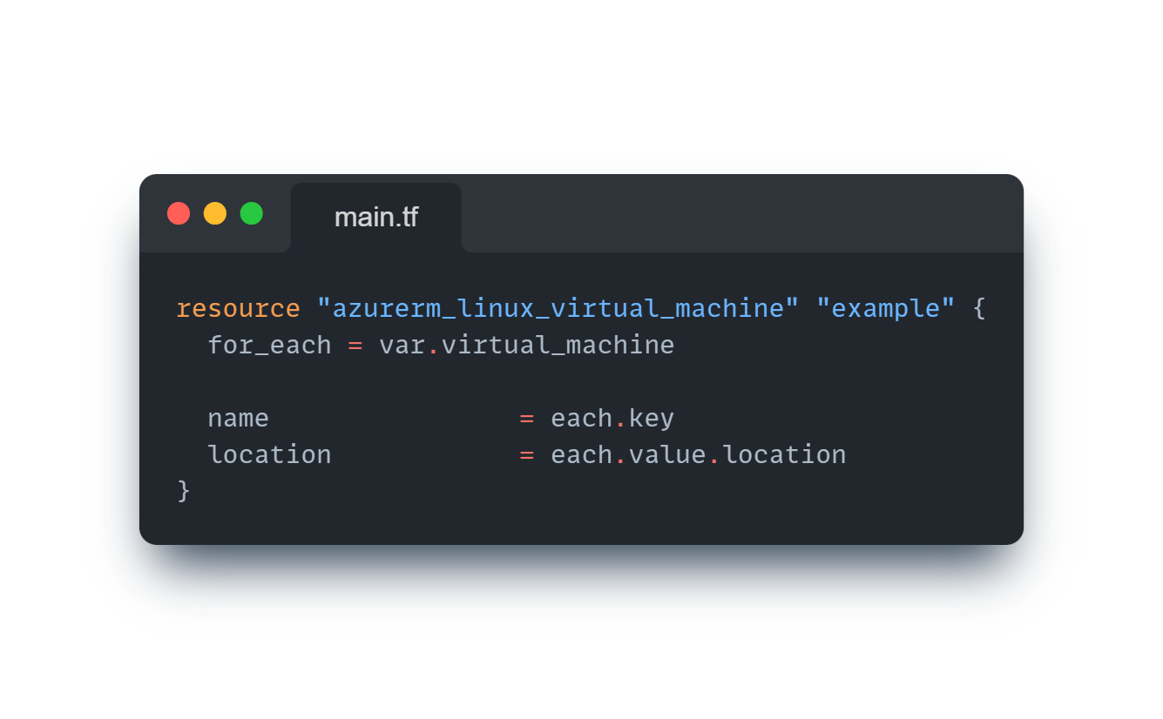
Tofu Advanced

Slide 10
Task
Create a new iterable variable named "containers" (tfvars file) that contains two Nginx containers.
  This variable should be structured exactly like in the previous example (see chat).
  The container names should be as follows, based on the example of the user "schulung1":
    schulung1-prod
    schulung1-test
  Both containers should use different Docker tags: nginx:1.26 and nginx:1.27.
  The last digit of the internal and external ports should correspond to the training participant's number, e.g., 8881, 8001, 8081, or 8401 (for the user "schulung1").
Declare the variable as type "any" (variable.tf).
Notes:
02a-vars

Slide 11
Tofu Basics
Hands On
Notes:
03-outputs
03a-outputs

Slide 12
Tofu Basics
Hands On
Notes:
04-modules

Slide 13
Task
Create a new module for the resource: "docker_image" without variables (hardcoded).
The module should download the following Docker image: "nginx:1.26" (main.tf resource block).
Within the module, create an output for the "image_id" of the newly created resource (output.tf).
Integrate the module into the root module (module block).
Display the module's output in the terminal (output.tf in the root module).
Notes:
04a-modules

Slide 14
Task
Pass the output of the "docker_image" module to the "docker_container" module.
  To achieve this, declare a new variable named "image_id" in the "docker_container" module.
  Assign the output of the "docker_image" module to the "image_id" variable of the "docker_container" module (root module main.tf).
  Use the new "image_id" variable in the main.tf file of the "docker_container" module as a variable.
Notes:
04a-modules

Slide 15


Terragrunt
Terragrunt

Slide 16
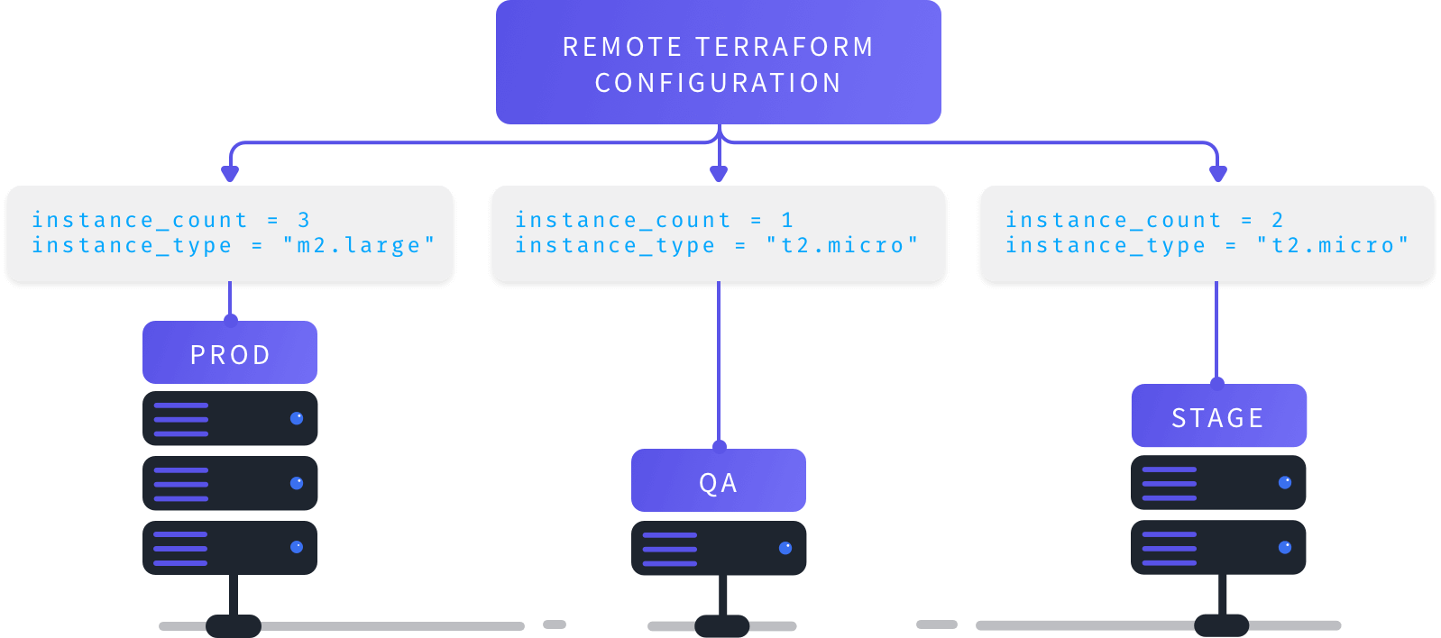
Terragrunt

Slide 17
Terragrunt Basics
Hands On
Notes:
05-terragrunt

Slide 18
Task
Create a parent terragrunt.hcl file that contains variables for both environments.
This parent terragrunt.hcl should include the containers variable in an inputs block (identical to the environment-specific terragrunt.hcl files).
  The variable in the parent terragrunt.hcl should contain only one container, which will be deployed in both Test and Prod environments.
Include the parent terragrunt.hcl in each environment-specific terragrunt.hcl file.
  The include should support variable merging, meaning that if a variable is defined in both terragrunt.hcl files, it should be merged or extended.
The Terraform block should be defined only in the parent terragrunt.hcl file.
Notes:
05a-terragrunt

